Slide 1
Build Power Platform complex Business applications using Custom connectors
Petar Gjeorgiev

Slide 2

Who is Petar?
Practice Unit Manager/Lead Technical Consultant at IWConnect
MS Certified Professional and Azure Solutions Architect
Pro Code Developer

Slide 3
Agenda
Introduction
Power Platform Connectors
Power App Canvas
Power Apps Component Framework (PCF)
Use Case
Demo
Q&A

Slide 4
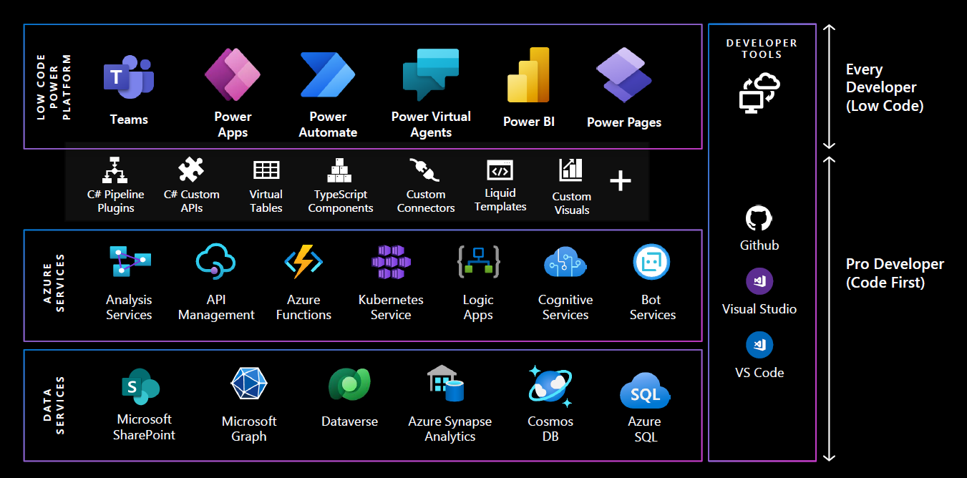
Introduction
4
Notes:
Low-code isn’t always low-complexity –but it will help reduce complexity.
We’ve seen jumps in abstraction before –but this time it’s with increased focus on:Connectivity
Security, Administration, Governance, & Monitoring
Application Life Cycle Management & Versioning
Modern Workplace Integration
Component based collaboration & co-authoring (often between pro-coders and low-code makers)

Slide 5
What are connectors?
Wrapper around an API that allows you to talk to Microsoft Power Platform Components
Provide a powerful and flexible way to integrate external data sources and services with Power Platform, enabling users to automate workflows, build custom apps, and analyze data.
5

Slide 6
connector types
custom
STANDARD
PREMIUM
Available in your own company or tenant
Have to be deployed
Have to be configured
Open for use in all licencing plans
Cover most commonly used data sources (SharePoint, OneDrive, GoogleDrive, Twitter,..)
Work without config
No need to deploy
Only available in Premium Licence Plan
Work without config
Cover external enterprise applications such as: Salesforce, Docusign, Amazon …
6
Notes:
Get your connector certified | Microsoft Learn

Slide 7
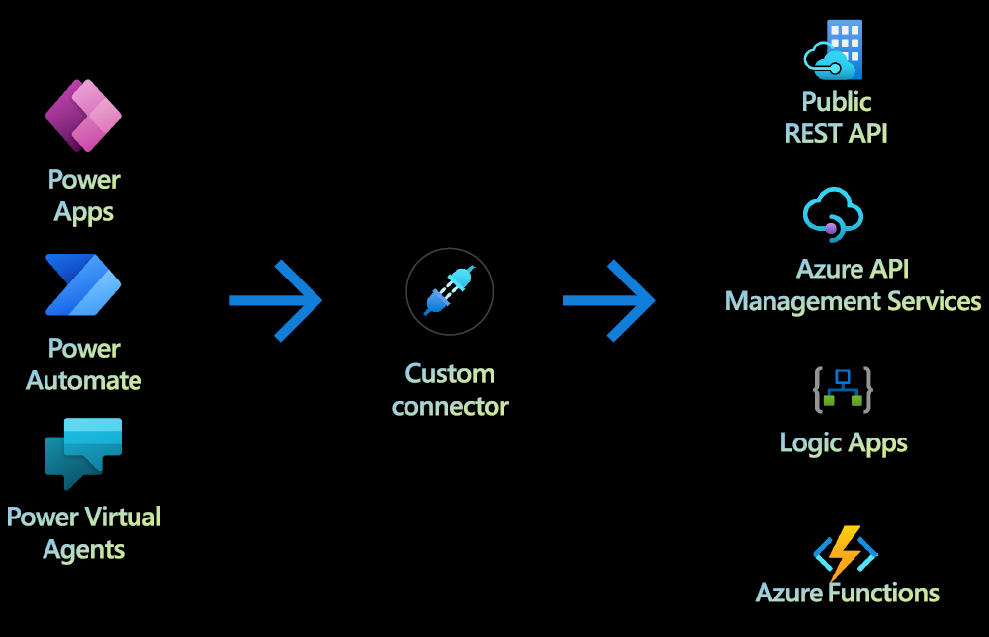
Custom Connector
7

Slide 8
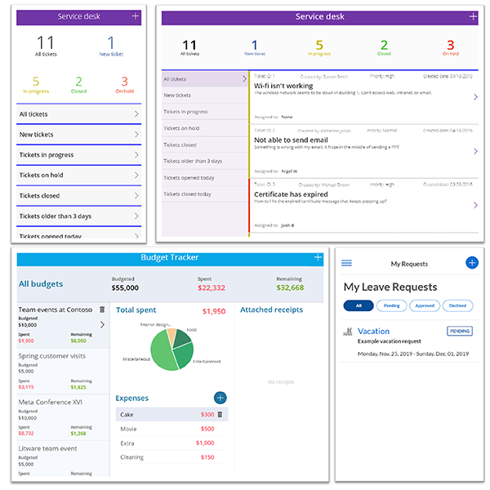
Power app canvas
A Canvas app is a ‘traditional’ app - the sort of mobile or tablet app built by dragging and dropping pre-built controls onto a blank canvas, and Excel-style expressions are written to specify logic and handle navigation
Integrate with data from a near limitless number of Microsoft and third-party data sources and build a pixel-perfect interface using buttons, lists, text inputs and more for a tailored user experience
Benefits:
Pixel-perfect customization
Sample drag and drop design environment
Excel-style business logic
Native AI tools, address and map inputs, offline capabilities, and more
8

Slide 9

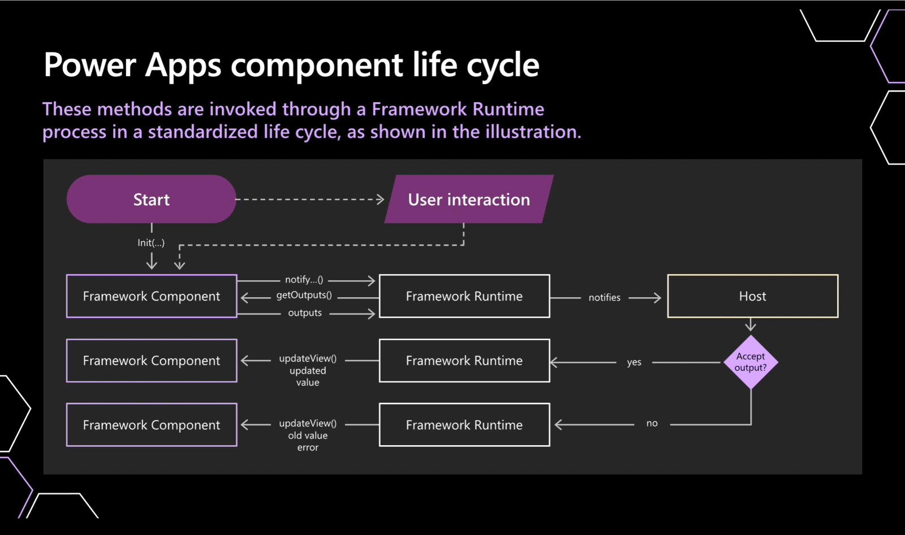
Power apps component framework (PCF)
Custom code components that extend your application when out-of-the-box connectors don’t fully meet your needs.
Components are all HTML or JavaScript but can support React and AngularJS as well. There is a PCF gallery that houses PCFs made by Microsoft developers and the Power Apps community, for any developer to leverage.
Components consists three elements:
XML Manifest file that describes metadata
Component Implementation (Code part)
Resources; tags in the manifest that refer to the resource that the component requires to implement its’ visualization. Examples are css, code, img, html, and resx
Components lifecycle metods:
init
updateView
getOutputs
destroy
9
Notes:
Microsoft Power Apps on Azure for Power Component Framework
https://pcf.gallery/
Ebook: Fusion development approach to building apps using Power Apps - Power Apps | Microsoft Learn
Init – Required. This method is used to init component instance.
updateView – Required. Called when any value in the component’s property bag has changed
getOutputs – Optional. – Called by framework propr to the receipt of new data. Used when dynamically managing bound properties in a control.
Destroy – Required. When component is removed from DOM tree

Slide 10
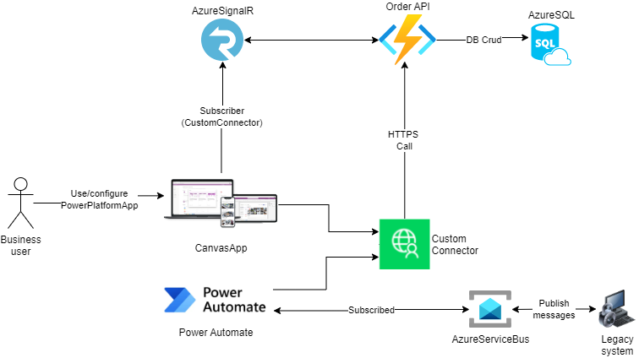
Use Case
10

Slide 11
Demo
11

Slide 12


EVENT Sponsors
iwconnect.com
it-labs.com
12

Slide 13
Any Questions?

Slide 14

Please fill out the survey! & Win Swags!!
https://bit.ly/GPPBSurvey

Slide 15
Resources
aka.ms/pp/dev - Microsoft Power Platform Developer Docs
aka.ms/pac/admin - Power Platform CLI
aka.ms/connectors - Power Platform Custom Connector Docs
aka.ms/canvas-apps - Canvas Apps Documentation
aka.ms/cc/coding-standards – Custom Connectors Coding Standards
aka.ms/cc/paconn - Custom Connector Paconn CLI
aka.ms/pp/ip-certification - Independent Publisher Connector certification
aka.ms/cc/github - Creator Kit Documentation
15

Slide 16
Thank you!
16

